Slide 1
Fundamentals of DATA analytics WITH TABLEAU
PROJECT TITLE:
IREVOLUTION:A DATA-DRIVEN EXPLORATION OF APPLE’S IPHONE IMPACT IN INDIA

Slide 2

PROJECT TITLE:
IRevolution: A Data-driven Exploration of Apple’s iPhone Impact in India.
This is a group project. We have include Five members on this Project. Namely,
I am the TEAM LEADER SANTHOSH K, TEAM PERSONS ARE AS FOLLOWS:
VIJAYAKANTH S, TAMILSELVAN L, RAGAVAN A, NISSHANTHRAJ T R.
Team NM ID :NM2023TMID28739
IIIrd B.Sc.Mathematics
S.NO | REG NUMBER | NAME | NM ID
1 | 31521U25007 | SANTHOSH K | AF303A58D8A2FFE91684AFA3069D5991
2 | 31518U25047 | VIJAYAKANTH S | 58D2F976286540193D34927211F418FD
3 | 31521U25008 | TAMILSELVAN L | B720EA2251445FF8FD3455D14AB8AF07
4 | 31521U25005 | RAGAVAN A | 58972AACDEC43E081604392B5FDEFA60
5 | 31521U25002 | NISSHANTHRAJ T R | 8E877945E2270FD9F2143FA0FC99AB0B
Under The Guidance of
D.TAMILSELVAN M.Sc., M.phil.,
ASSISTANT PROFESSOR PG & RESEARCH DEPARTMENT OF MATHEMATICS,
K.M.G COLLEGE OF ARTS AND SCIENCE,
GUDIYATTAM-635803.

Slide 3
1. INTRODUCTION
1.1. OVERVIEW
iRevolution: A Data-driven Exploration of Apple’s
iPhone Impact in India is a comprehensive research study that
seeks to shed light on the influence of Apple’s iconic iPhone in the India context. By employing data-driven approaches, this
research explores how iPhones have shaped various aspects of
India society, from technology adoption to economic dynamics.

Slide 4
1.2. PURPOSE
Let us analyze a Data-driven Exploration of Apple’s iPhone for the Data set collected.
Let us ask interesting questions on existing data, Apple’s iPhone and it’s Model Specification Explanation and Model- Wise Shares

Slide 5
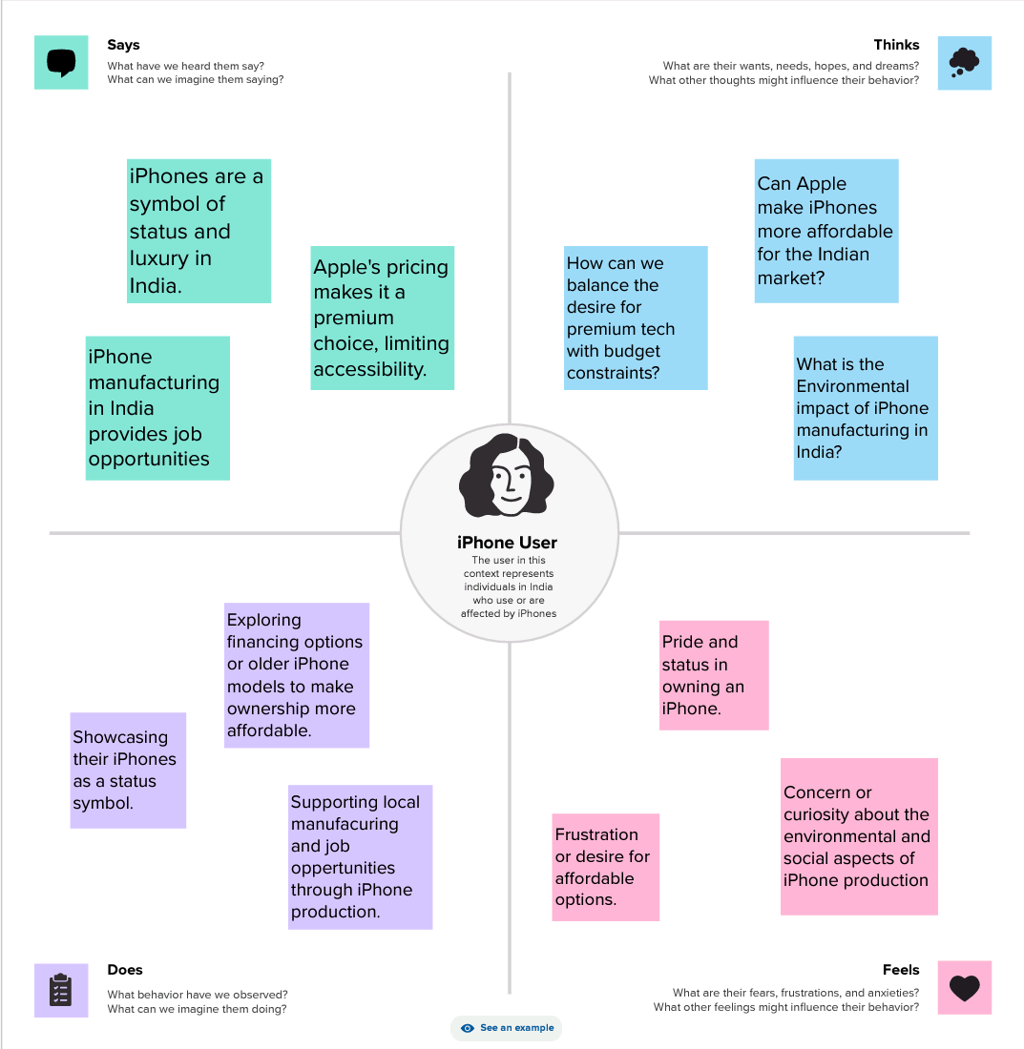
2. PROBLEM DEFINING & DESIGN THINKING
2.1 EMPATHY MAP

Slide 6
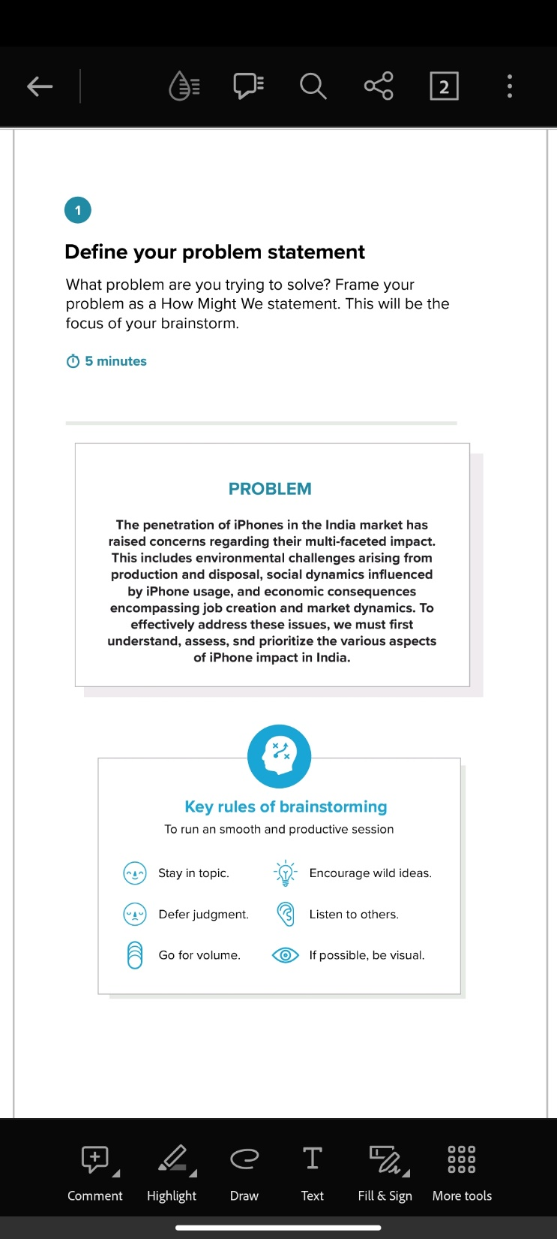
2.2.1 IDEATION & BRAINSTORMING MAP

Slide 7
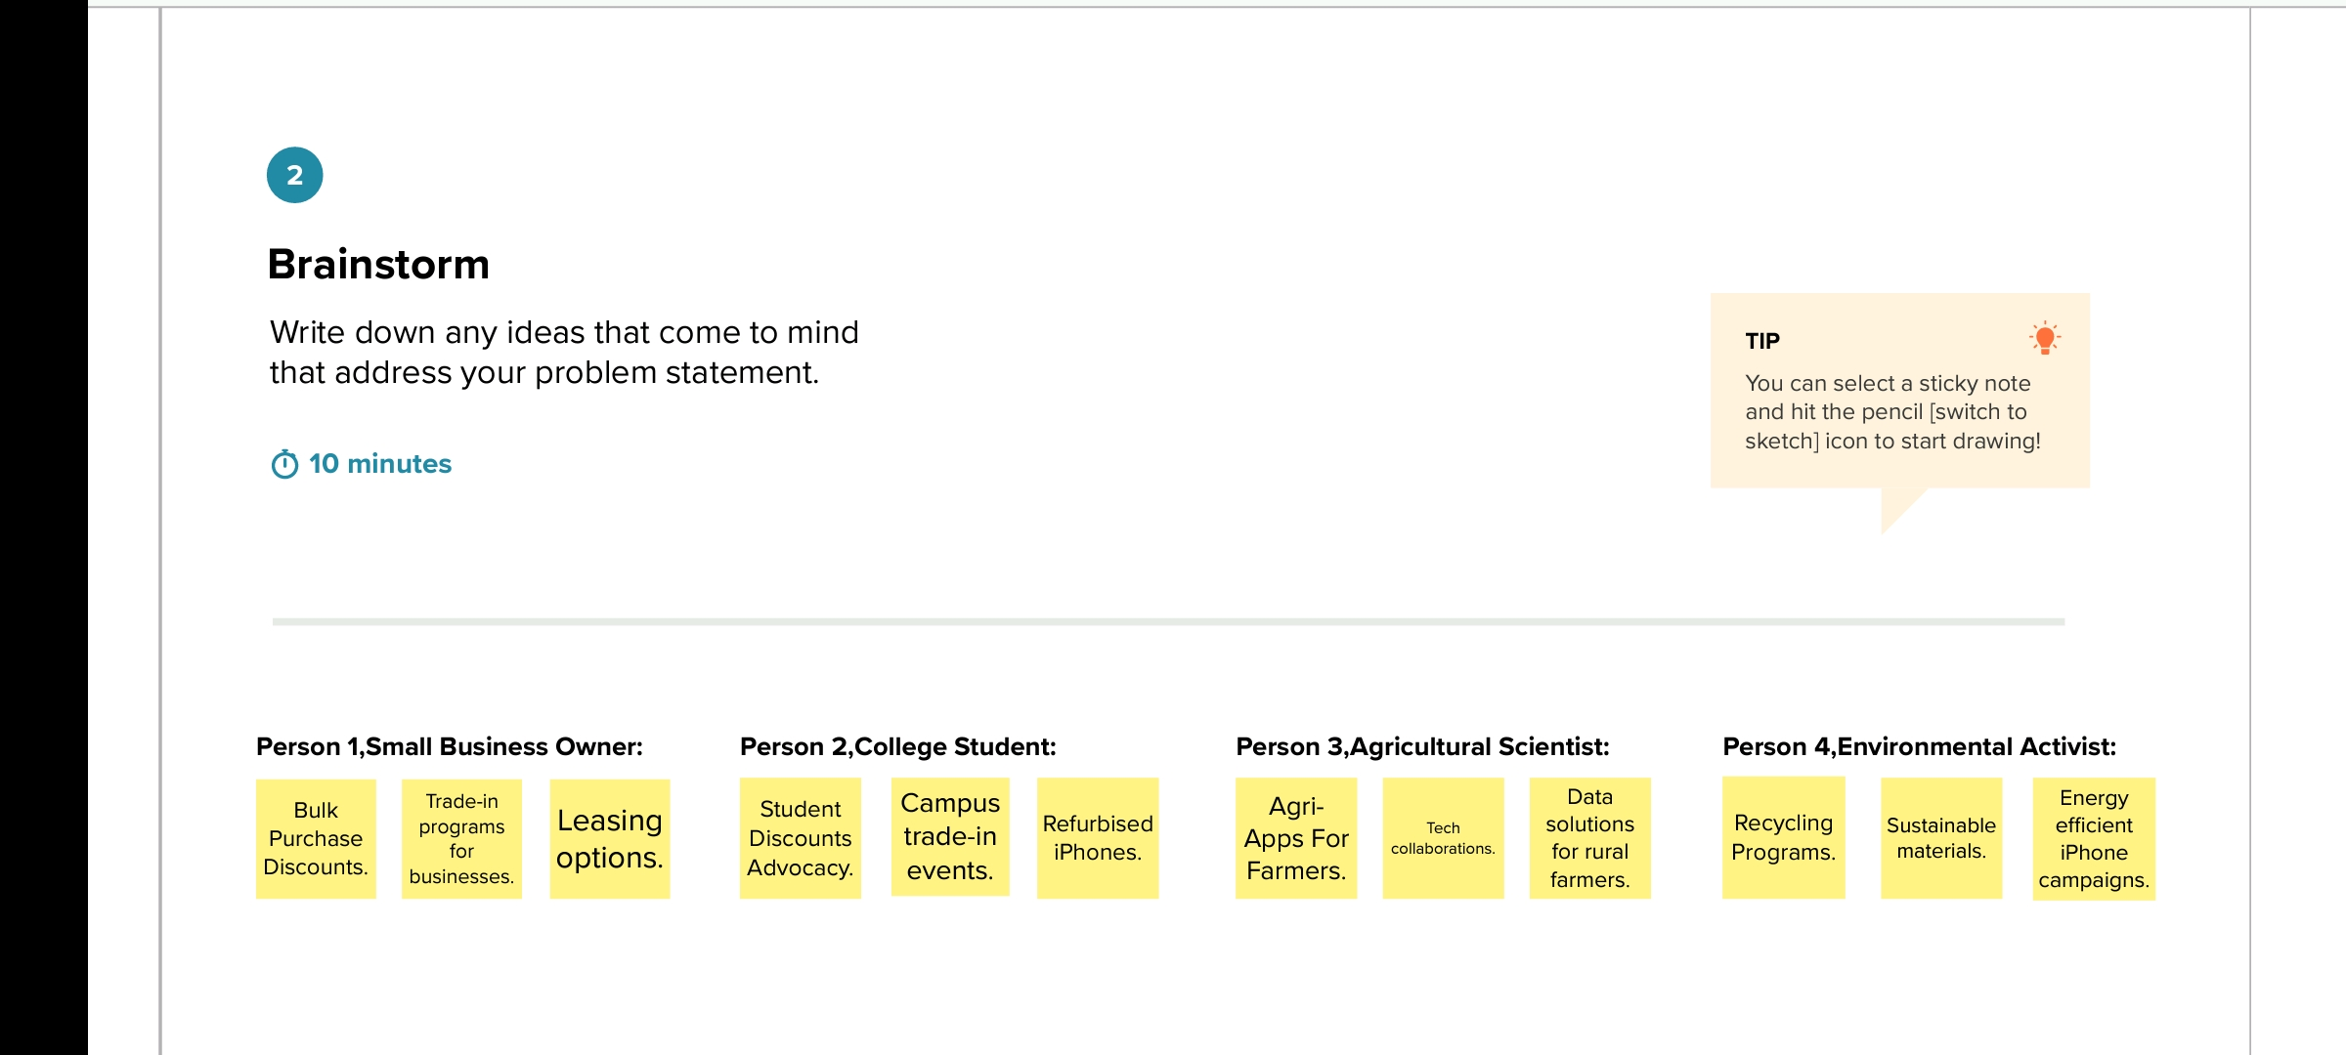
2.2.2 IDEATION & BRAINSTORMING

Slide 8
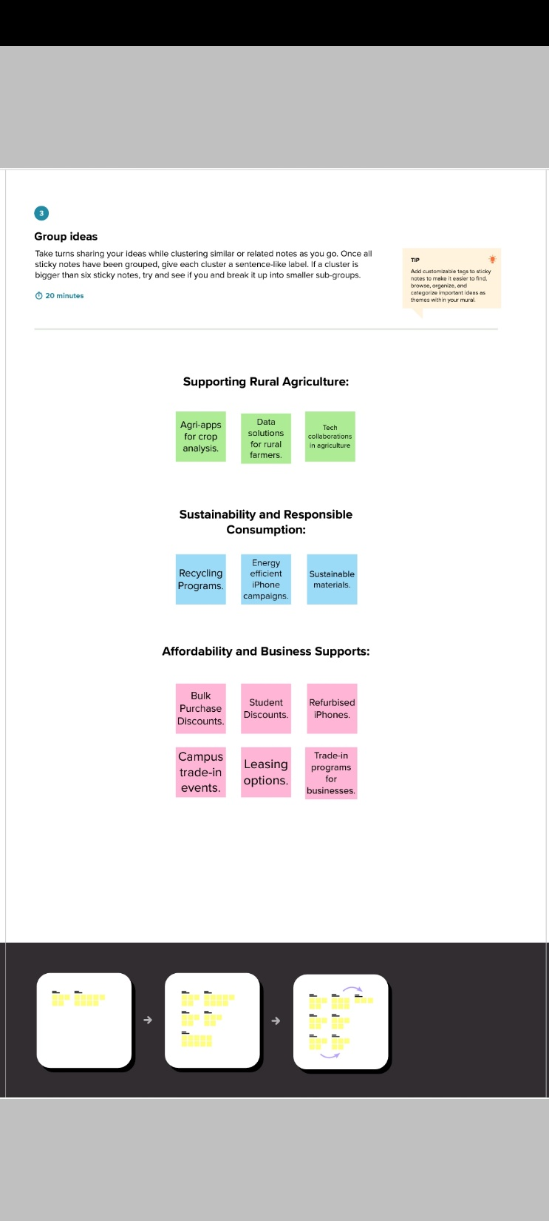
2.2.3 IDEATION & BRAINSTORMING

Slide 9
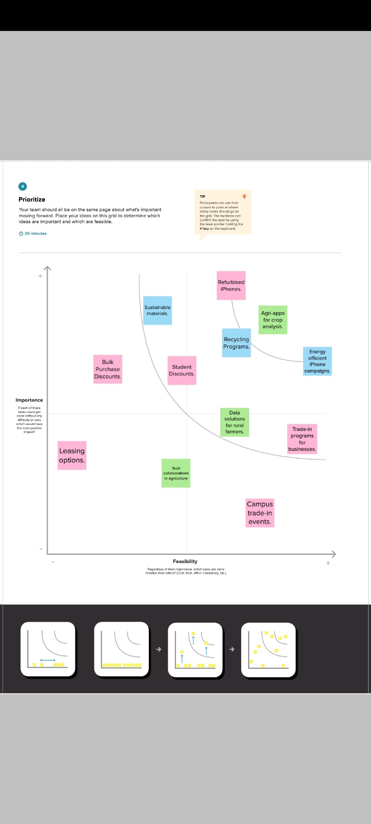
2.2.4. IDEATION & BRAINSTORMING

Slide 10
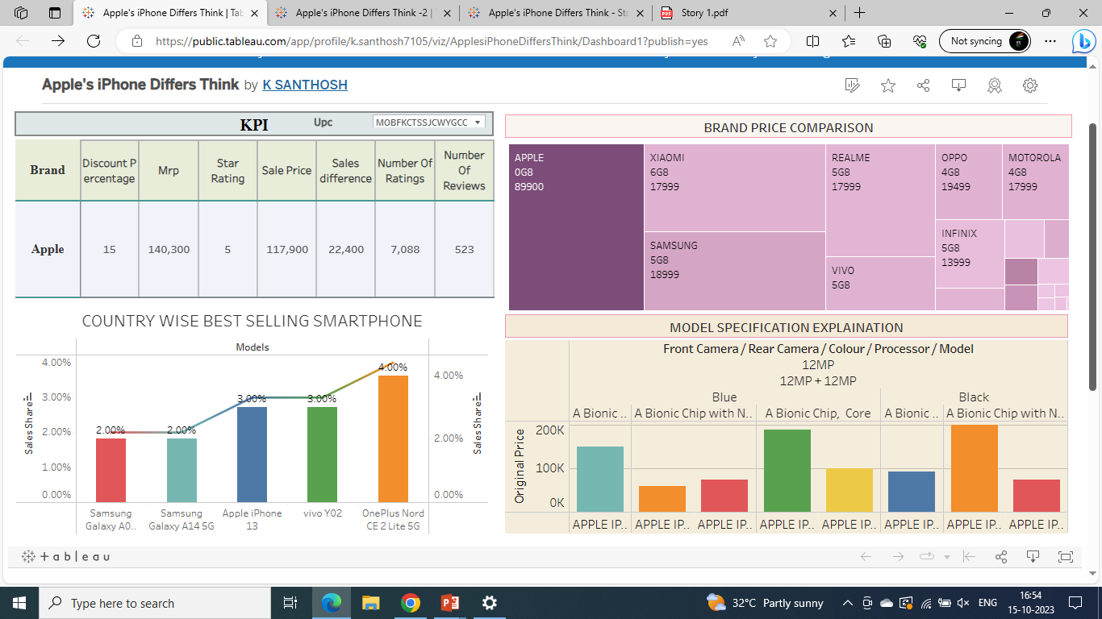
3. RESULT: Final findings (Output) of the project.
Dash Board 1:

Slide 11
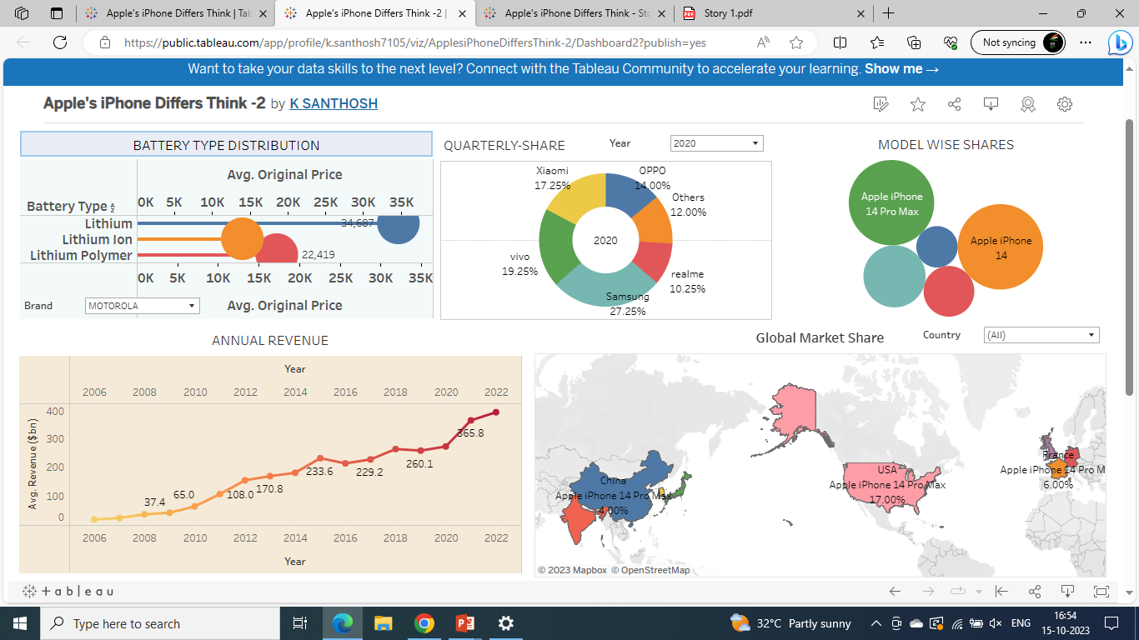
Dash Board 2:

Slide 12
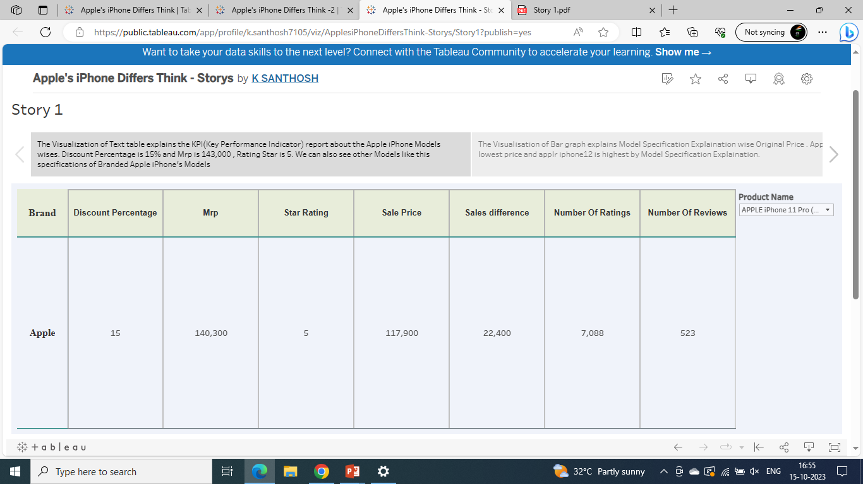
Story
Visualization 1:

Slide 13
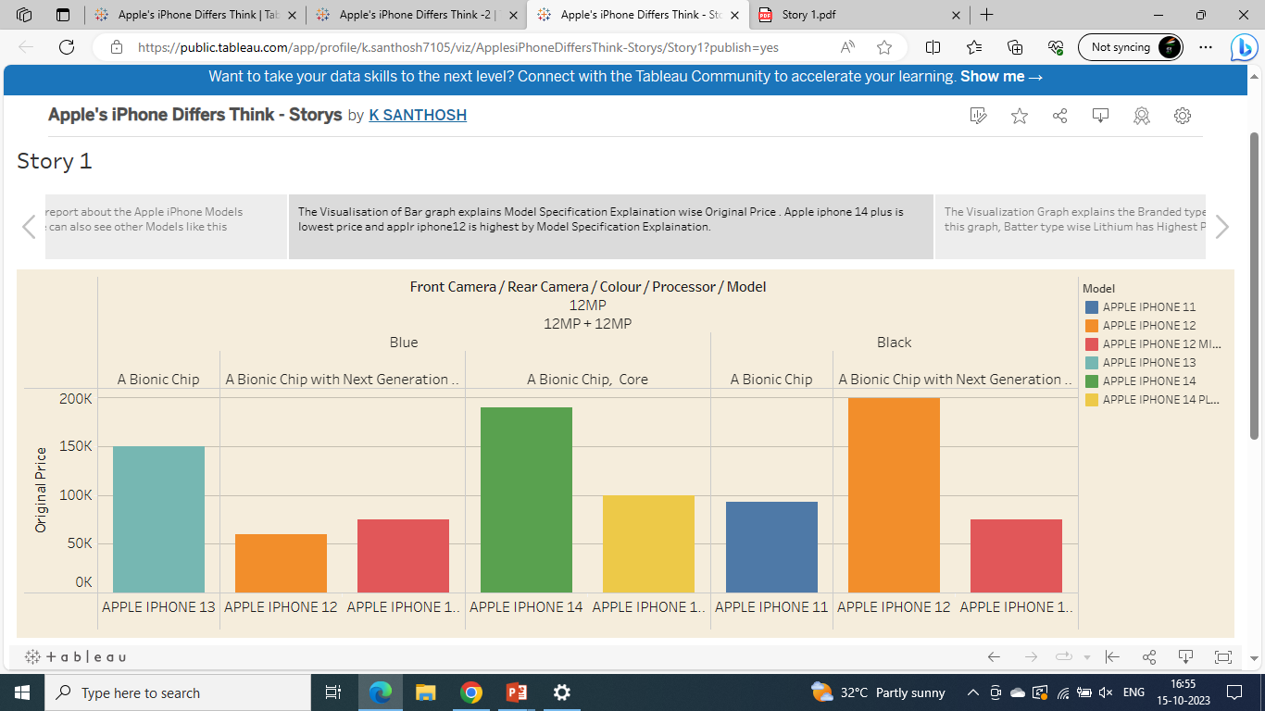
Story
Visualization 2:

Slide 14
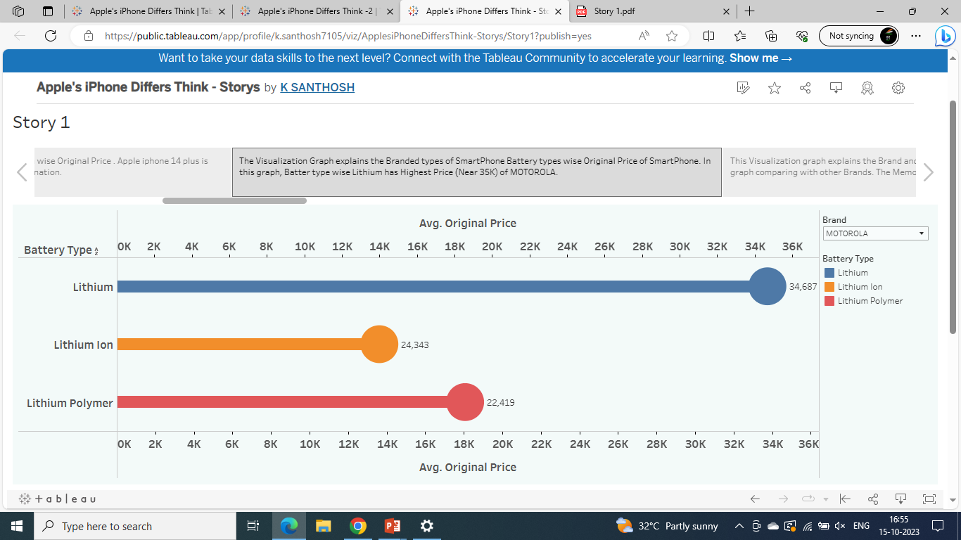
Story
Visualization 3:

Slide 15
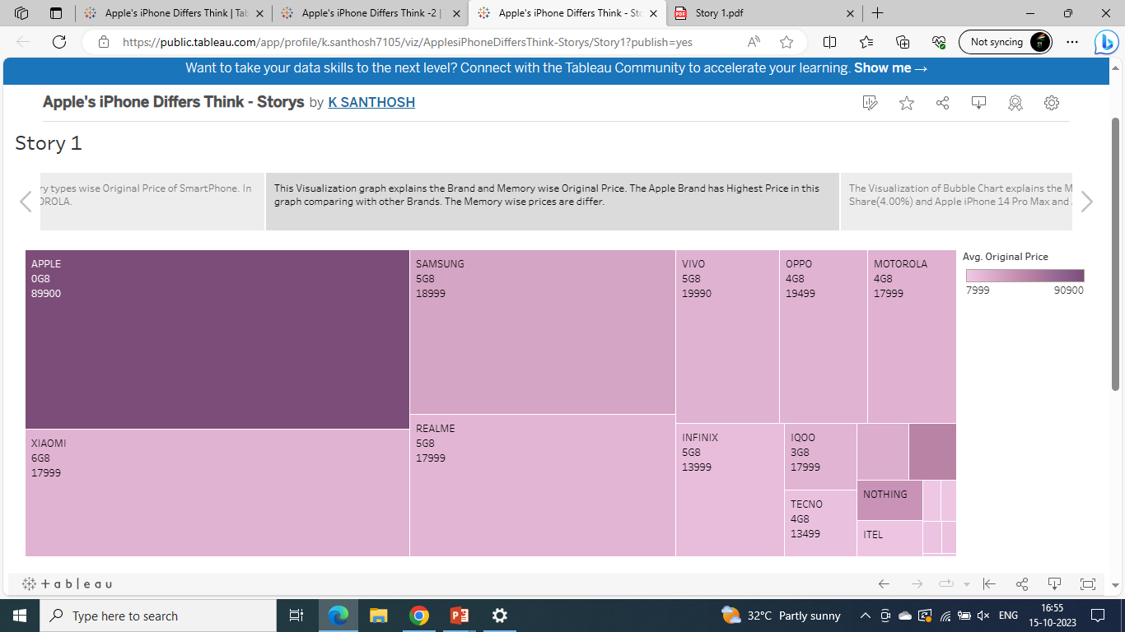
Story
Visualization 4:

Slide 16
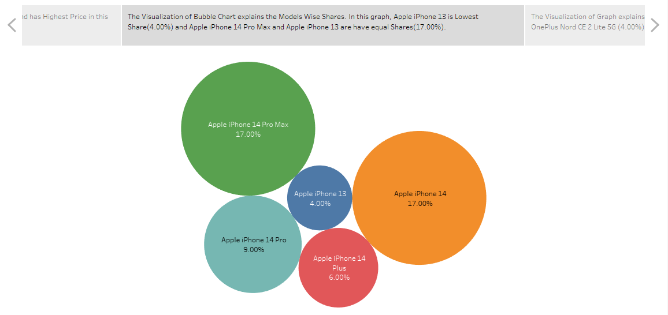
Story
Visualization 5:

Slide 17
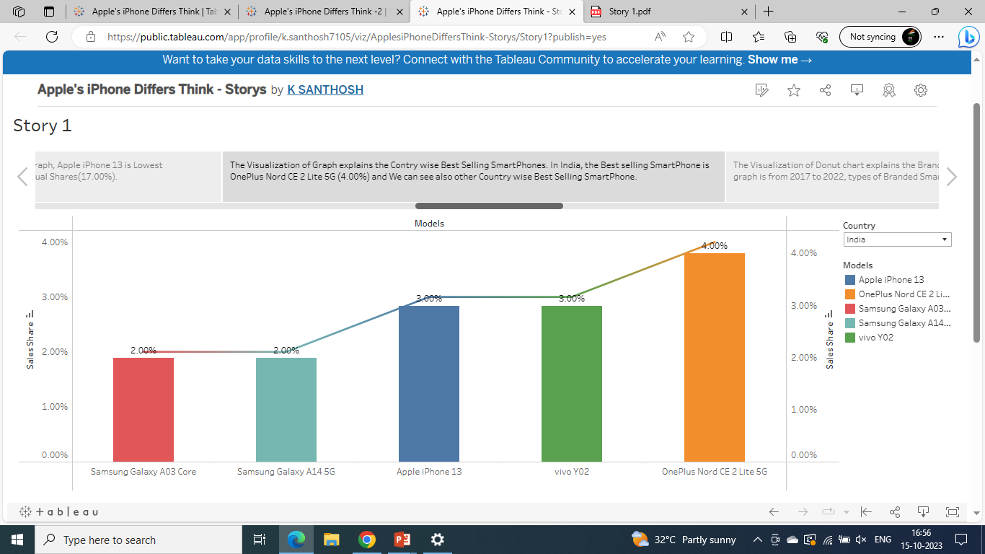
Story
Visualization 6:

Slide 18
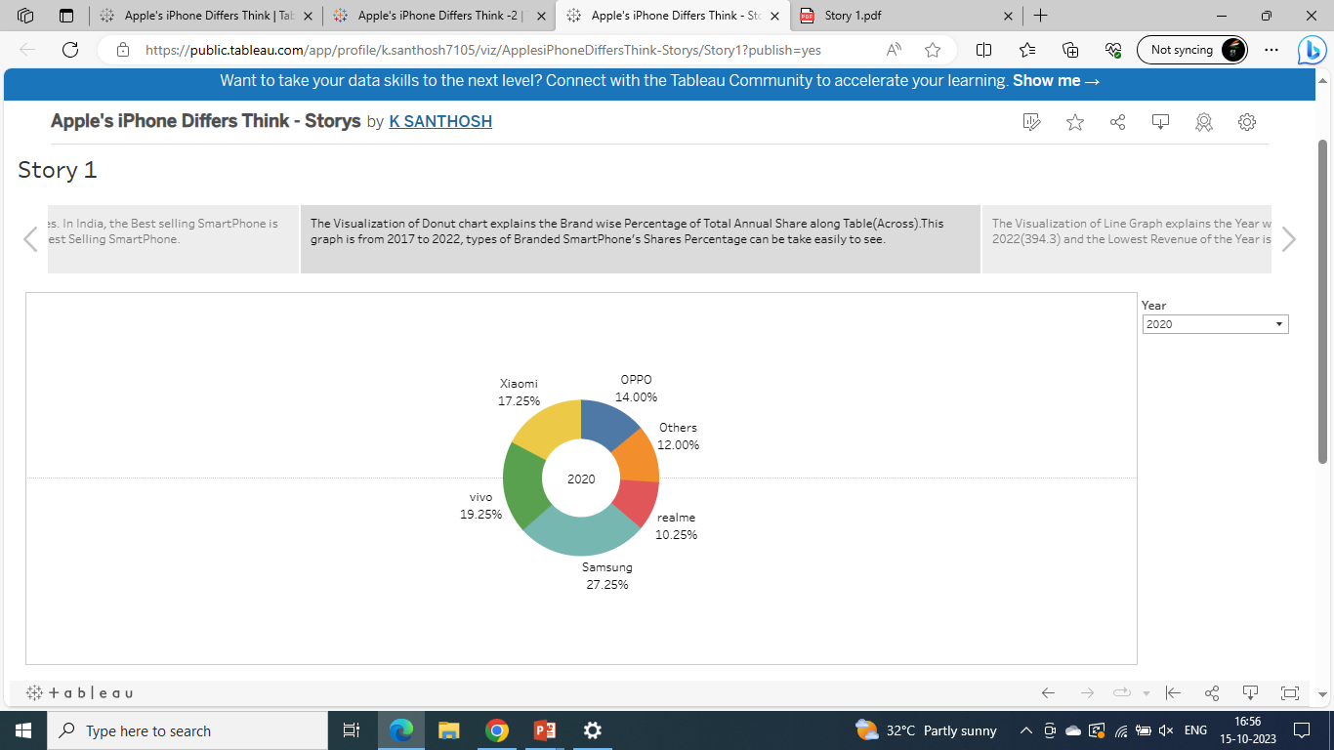
Story
Visualization 7:

Slide 19
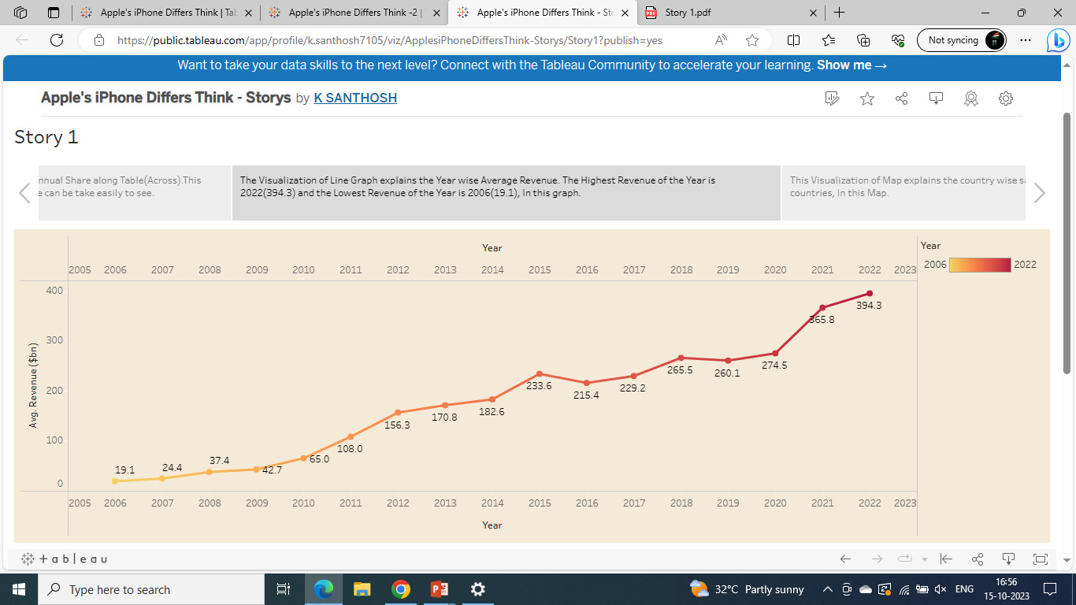
Story
Visualization 8:

Slide 20
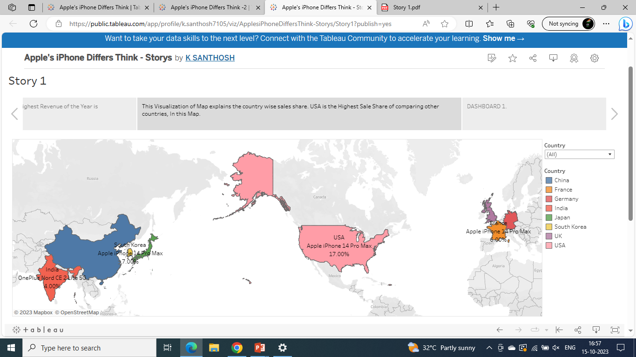
Story
Visualization 9:

Slide 21
DASHBOARD LINK:
DASHBOARD LINK 1:
https://public.tableau.com/views/ApplesiPhoneDiffersThink/Dashboard1?:language=en-US&publish=yes&:display_count=n&:origin=viz_share_link
DASHBOARD LINK 2:
https://public.tableau.com/views/ApplesiPhoneDiffersThink-2/Dashboard2?:language=en-US&publish=yes&:display_count=n&:origin=viz_share_link
STORY LINK:
https://public.tableau.com/views/ApplesiPhoneDiffersThink-Storys/Story1?:language=en-US&publish=yes&:display_count=n&:origin=viz_share_link

Slide 22
4.ADVANTAGES & DISADVANTAGES :
ADVANTAGES | DISADVANTAGES
ECONOMIC GROWTH: The penetration of iPhones in the India market has generated substantial revenue, both for Apple and the Indian economy. This has led to job creation and stimulated ancillary industries. | HIGH PRICE POINT: The cost of iPhones is considerably higher compared to many other smartphones available in India, limiting their accessibility to a significant portion of the population.
TECHNOLOGICAL ADVANCEMENT: iPhones have played a pivotal role in raising the bar for technological innovation in India. | MARKET DOMINANCE: Apple’s dominance in the premium smartphone segment may hinder competition and potentially stifle innovation, restricting consumer choices.
BRAND IMAGE: The iPhone’s premium brand image has not only attracted Indian consumers but also enhanced the reputation of the Indian smartphone market as a whole. | E-WASTE AND SUSTAINABILITY: Frequent smartphone upgrade and Apple’s closed ecosystem can contribute to electronic waste and present challenges in terms of recycling and sustainability.
ECOSYSTEM INTEGRATION: The iPhone seamlessly integrates with other Apple products and services, fostering brand loyalty and creating a network effect in India. | IMPORT DEPENDENCE: A substantial proportion of iPhones and their components are imported, contributing to trade imbalances and making the supply chain vulnerable to disruptions.

Slide 23
5. Applications:
1. ECONOMIC RESEARCH:
iRevolution can provide valuable insights for economists, policymakers, and business looking to understand the economic impact of Apple’s iPhone in India.
2. MARKET STRATEGY:
Companies in the smartphone industry can benefit from the study’s findings to refine their market strategies and product offerings in the Indian market.
3. TECHNOLOGY DEVELOPMENT:
The research can guide technology firms in India to identity areas where they can compete and innovate effectively in response to the iPhone’s influence.

Slide 24
6. CONCLUTION:
iRevolution: A Data-driven Exploration of Apple’s iPhone Impact in India illuminates the multifaceted effects of iPhones in India. While it has fueled economic growth, technological progress, and brand recognition, challenges such as pricing, market dominance, and sustainability issues remain. An informed and balanced approach is essential to fully comprehend the scope of Apple’s iPhone impact in India and to navigate its implications effectively.

Slide 25
THANK YOU

